Slide 1
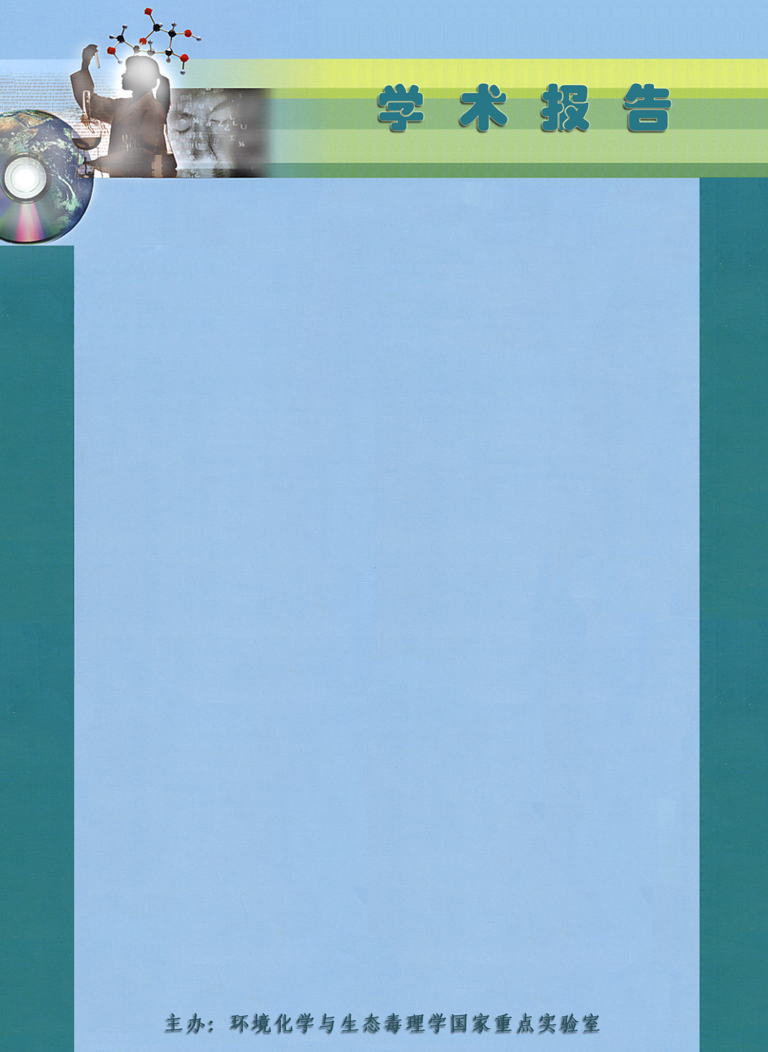
科技论文写作讲座
Publishing in Academic Journals – Tips to Help You Succeed
Dr. Andrew Kelly
Managing Editor, Earth & Environmental Sciences
Taylor & Francis Group
时间：2016年7月15日10:40
地点：环境科学楼311会议室
Dr. Andrew Kelly earned his PhD in Chemistry from the University of Bath in 2008, and spent two years as a Postdoctoral Research Officer at the University of Bath. In 2009, he moved to Wiley-VCH in Weinheim, Germany, where he began his career in publishing as Assistant and then Associate Editor of Angewandte Chemie. In 2012, he returned to the UK and took up the position of Books Production Editor at Taylor & Francis. In 2014, he moved to his current role as Managing Editor of the Earth & Environmental Science journals, and have recently taking on the responsibility for looking after the journal Chemical Speciation & Bioavailability.

